Slide 1
VLSI Final Project
4-bit Adder using
Ripple Carry
& Carry lookahead Generator

Slide 2
AGENDA
Introduction​
Implementation
1- bit full adder
4- bit full adder ripple carry
4- bit full adder Carry lookahead
Summary​

Slide 3
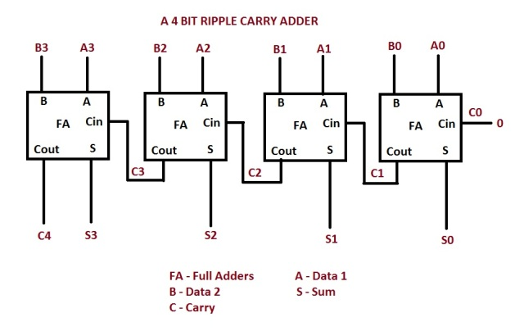
INTRODUCTION
4-Bit Ripple Carry Adder
A system of ripple-carry adders is a sequence of standard full adders that makes it possible to add numbers that contain more bits than that of a single full adder.
Each full adder has a Carry_in (Cin) and a Carry_out (Cout) bit, and the adders are connected by connecting Cout on step k to Cin on step k+1.
The challenge with ripple-carry adders, is the propagation delay of the carry bits.

Slide 4
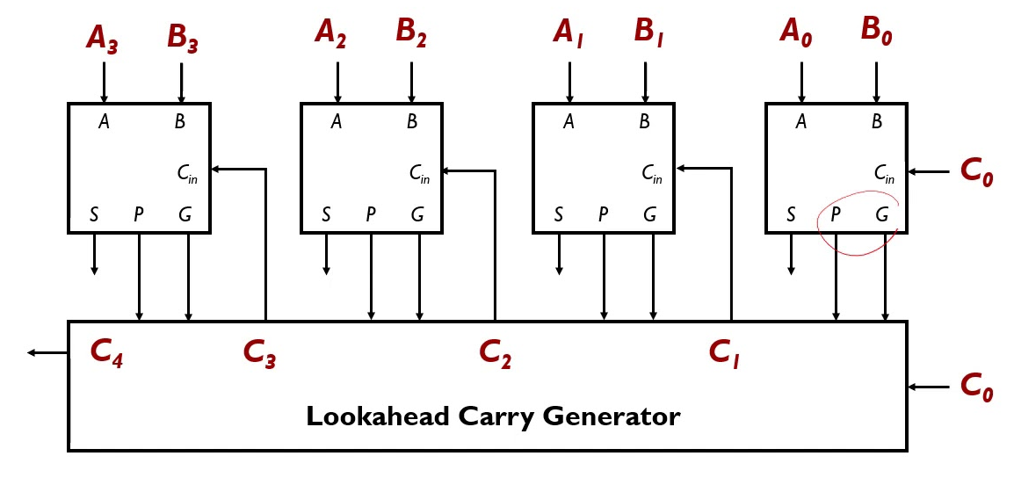
INTRODUCTION
4-Bit Carry Lookahead Adder
As the carry propagation time is the major speed limiting factor we use system of ripple-carry adders which eliminate the dependency between 1-Bit FA blocks a as it consists of :
4-Bit adder without carry
Logic block to generate P and G of each input.
Lookahead Carry Generator
The challenge with carry lookahead adders, is the area and that it requires complex design of lookahead carry generator.

Slide 5
Ripple carry adder

Slide 6
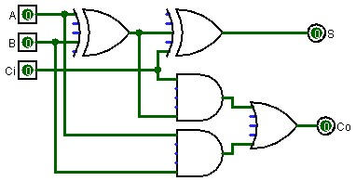
Implementation
4-Bit Ripple Carry Adder
1-bit full adder

Slide 7
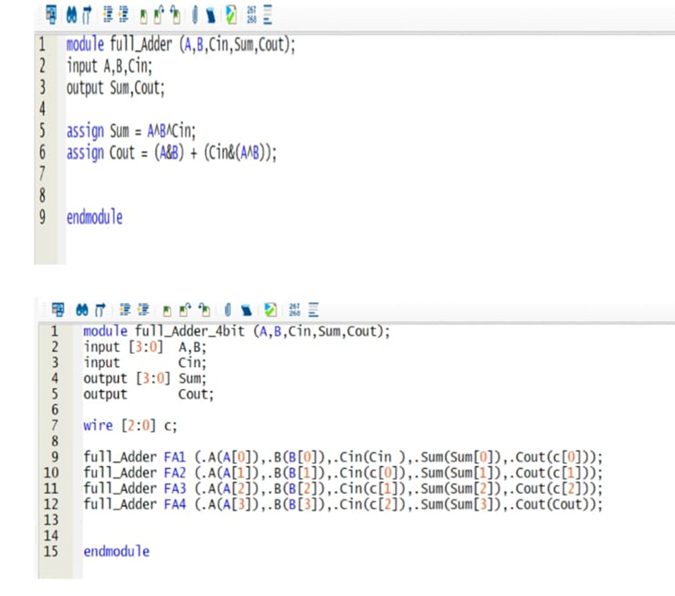
Implementation
4-Bit Ripple Carry Adder RTL

Slide 8
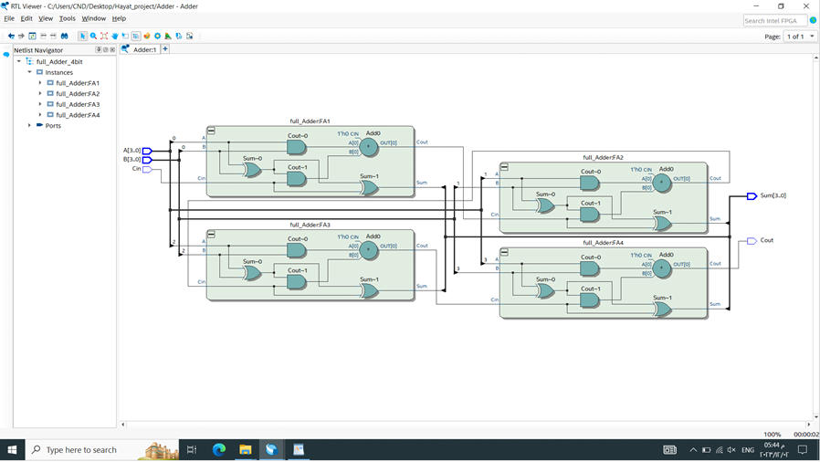
Implementation
4-Bit Ripple Carry Adder Output Netlist

Slide 9
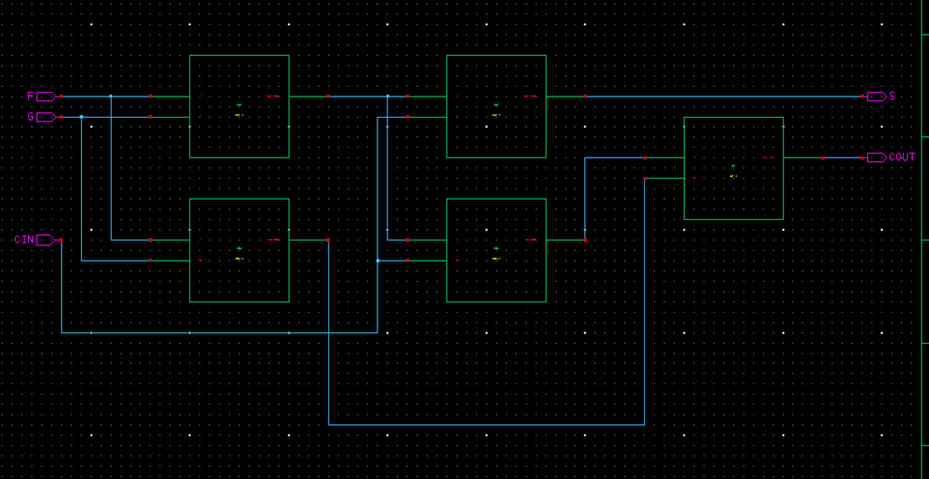
1-Bit FULL ADDER RIPPLE CARRY
Schematic

Slide 10
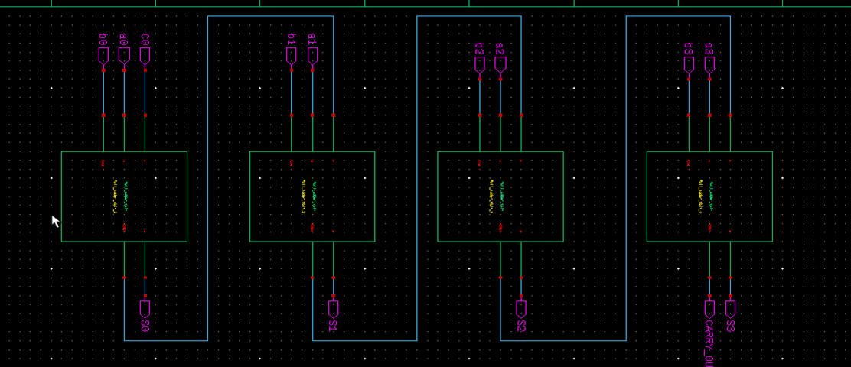
4-Bit FULL ADDER RIPPLE CARRY
Schematic

Slide 11
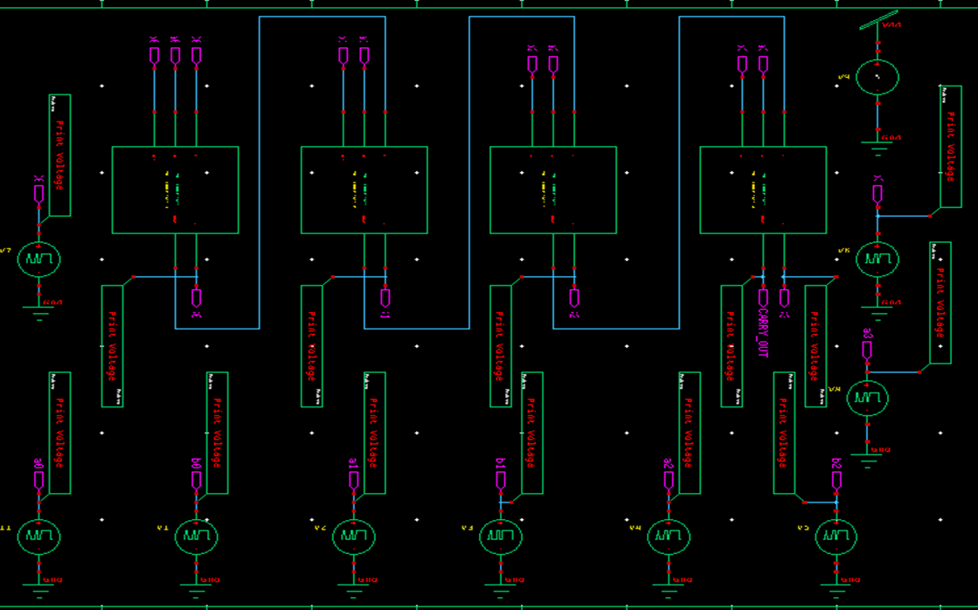
TESTBENCH of ripple carry adder

Slide 12
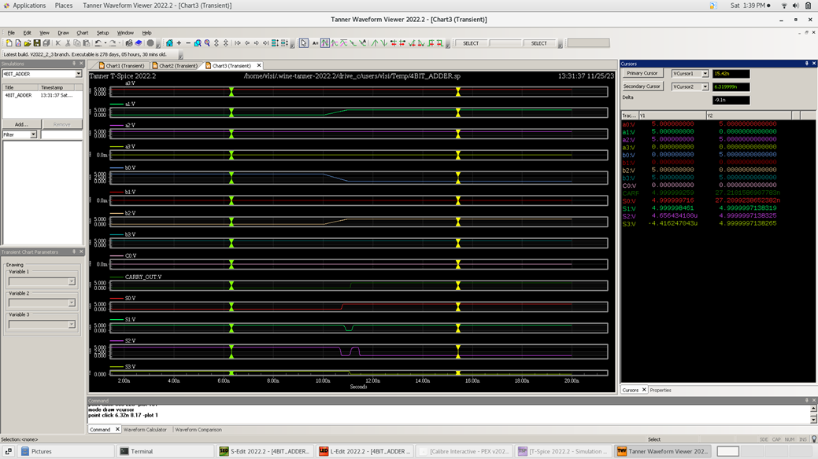
Simulation Results
First Pattern : 0101 + 1001 + 0 = 01110
Second Pattern : 0111 + 1100 + 0 = 10011
12

Slide 13
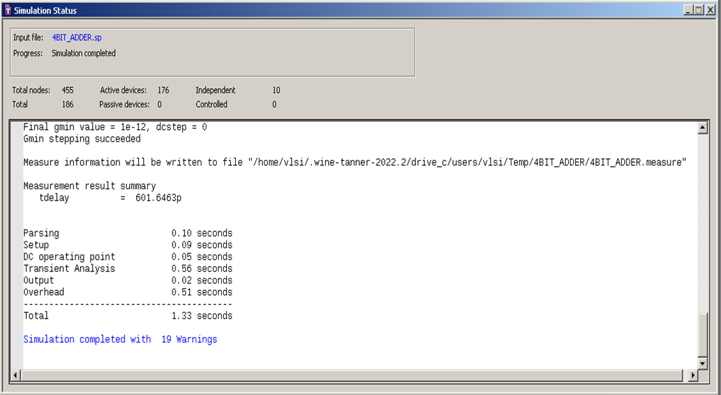
Simulation Results
Delay Calculations : Worst Case Delay
13

Slide 14
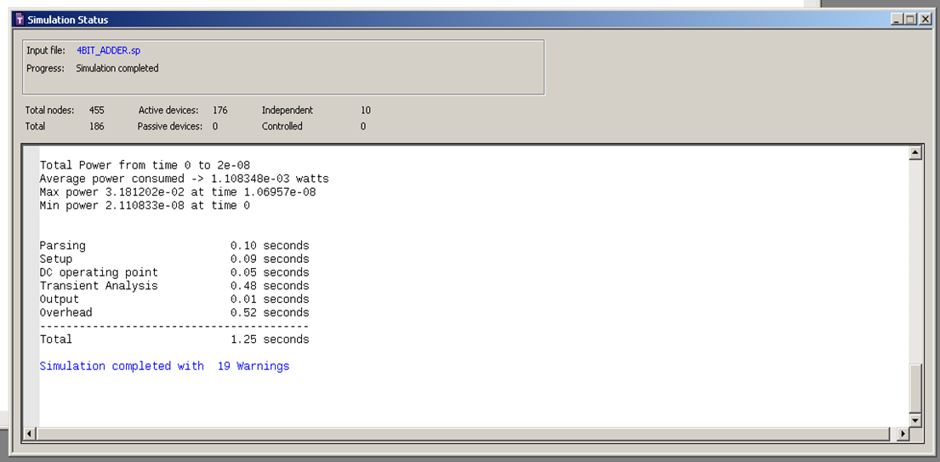
Simulation Results
Power Calculations
14

Slide 15
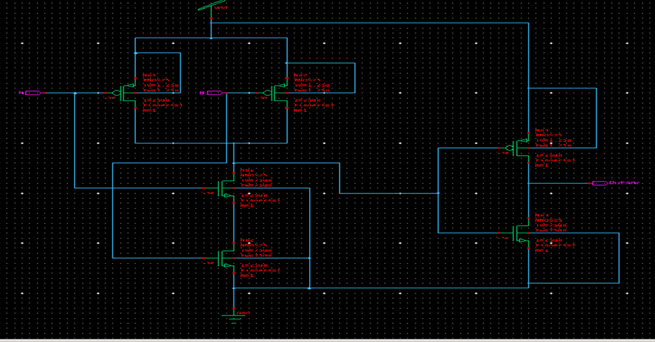
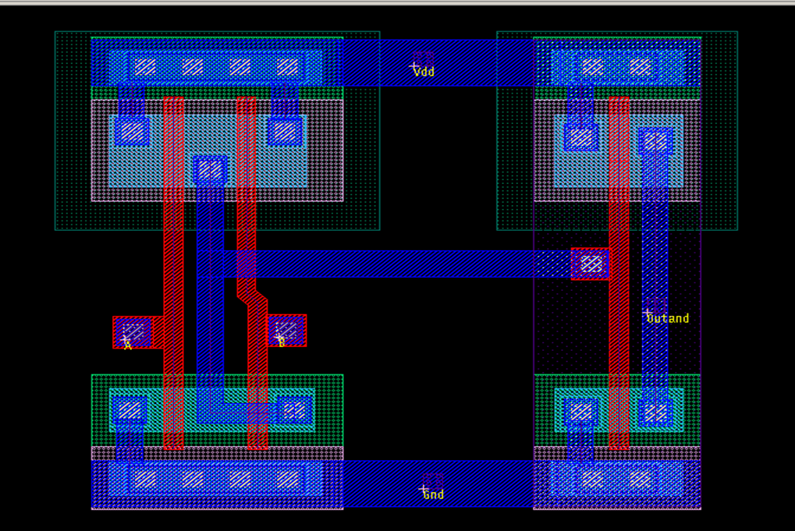
Basic Components
AND GATE
- schematic
- Layout

Slide 16
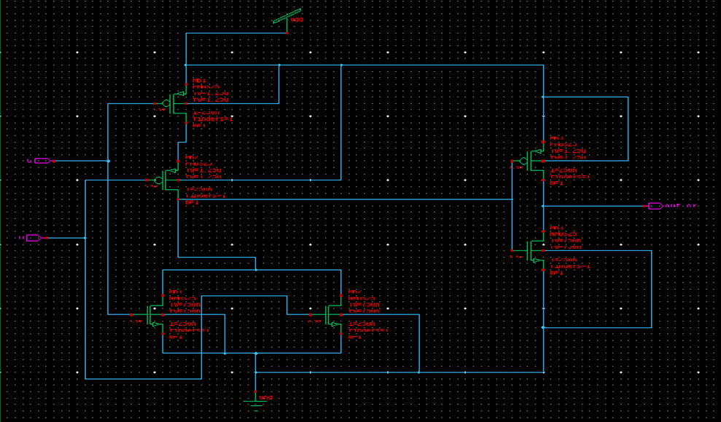
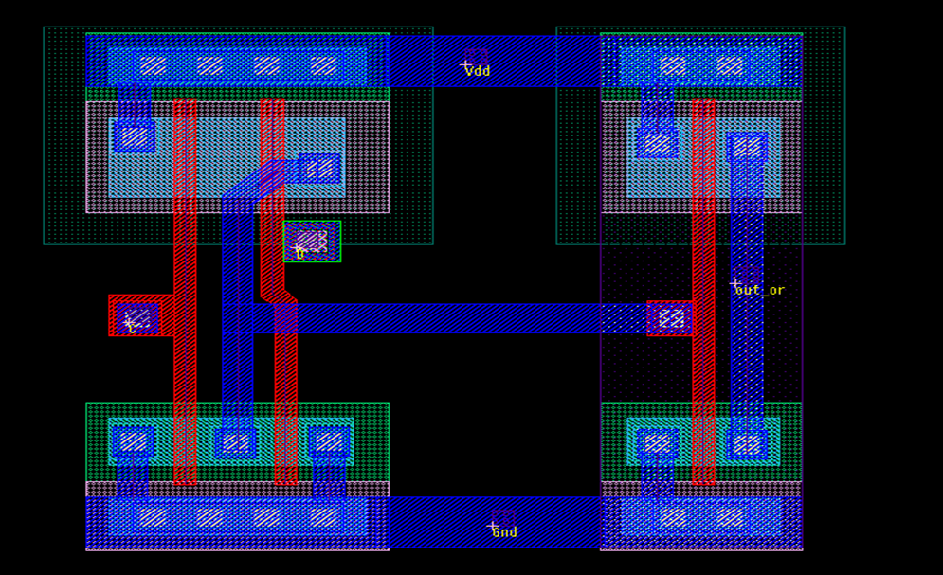
Basic Components
OR GATE
- schematic
- Layout

Slide 17
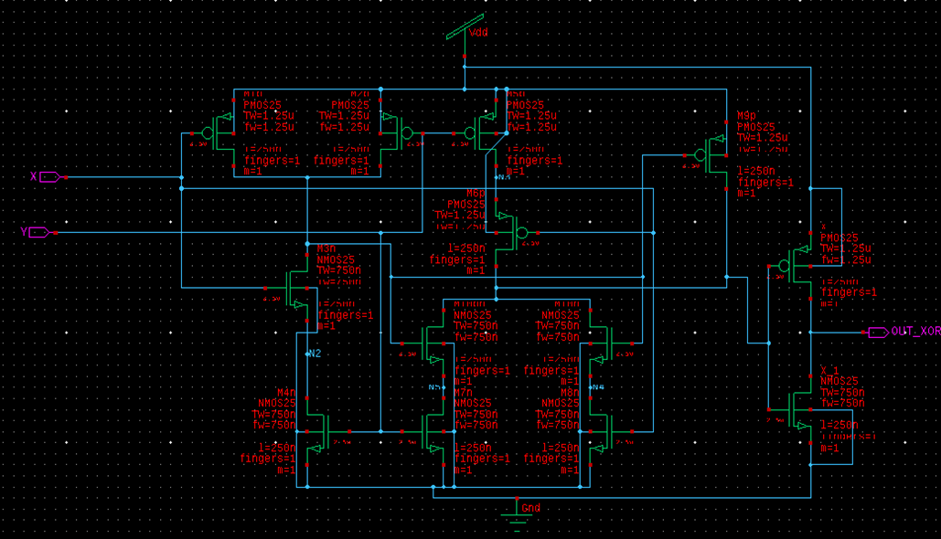
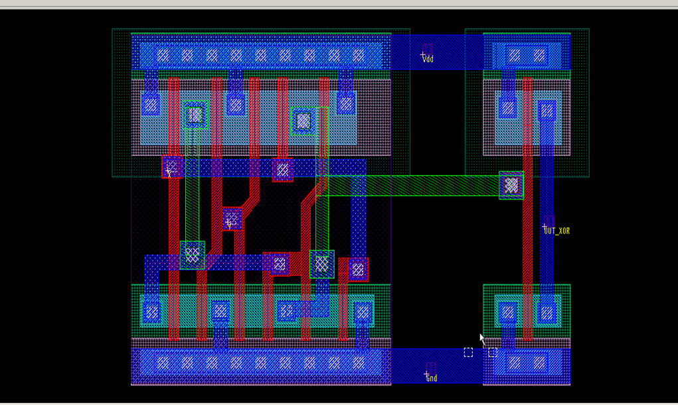
Basic Components
XOR GATE
- schematic
- Layout

Slide 18
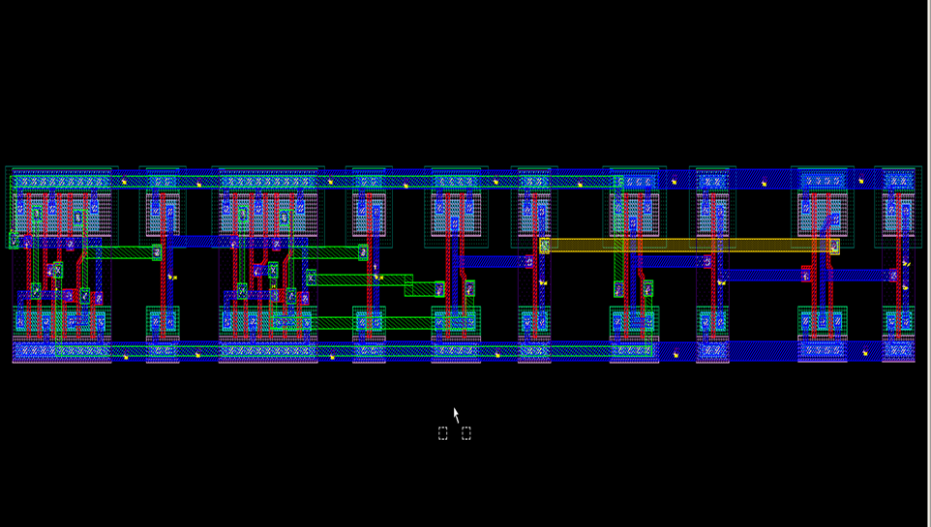
1-Bit FULL ADDER RIPPLE CARRY
Layout

Slide 19
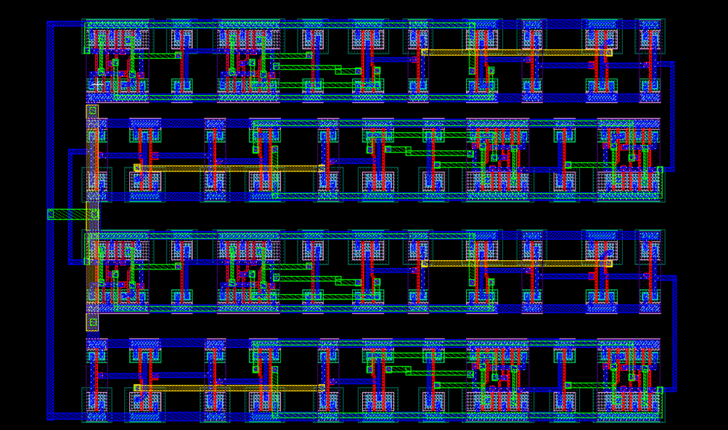
4-Bit FULL ADDER RIPPLE CARRY
Layout

Slide 20
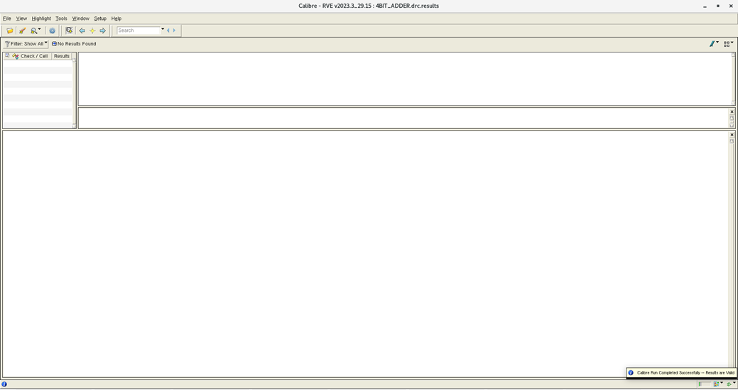
DRC CHECK

Slide 21
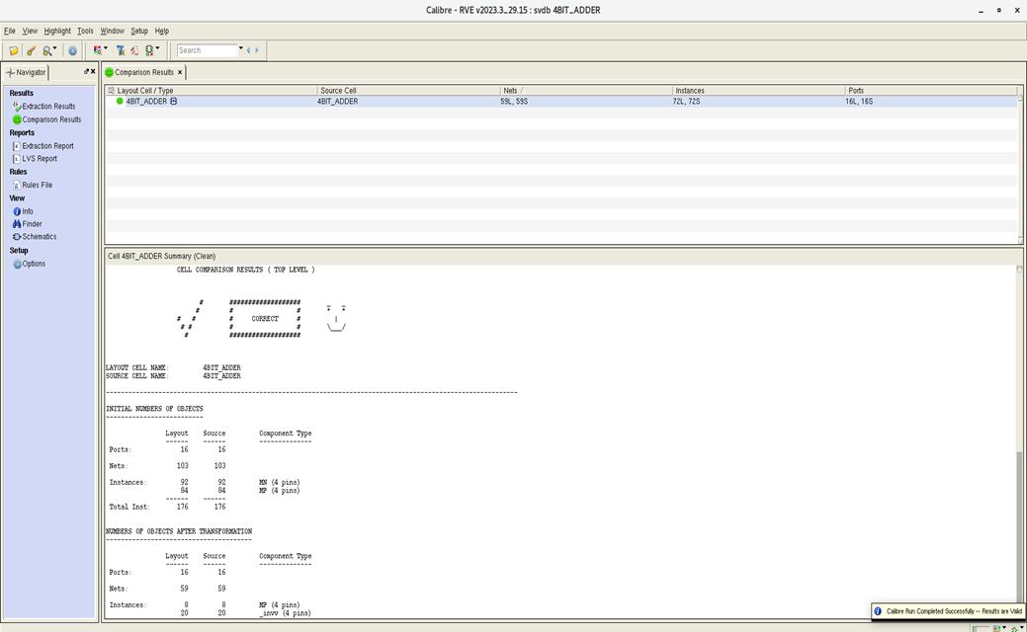
LVS CHECK

Slide 22
Carry Lookahead Adder

Slide 23
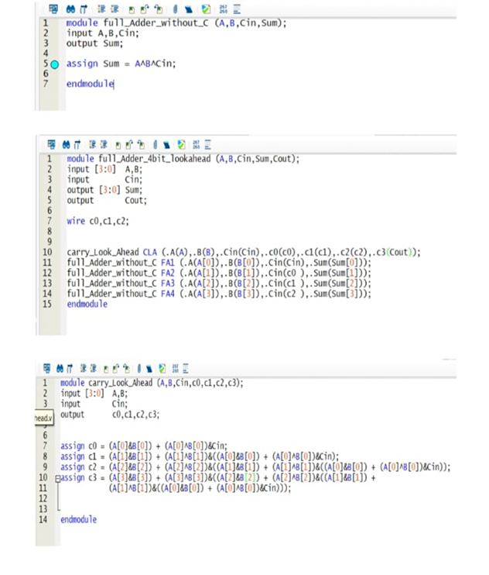
Implementation
4-Bit Carry Lookahead Adder RTL

Slide 24
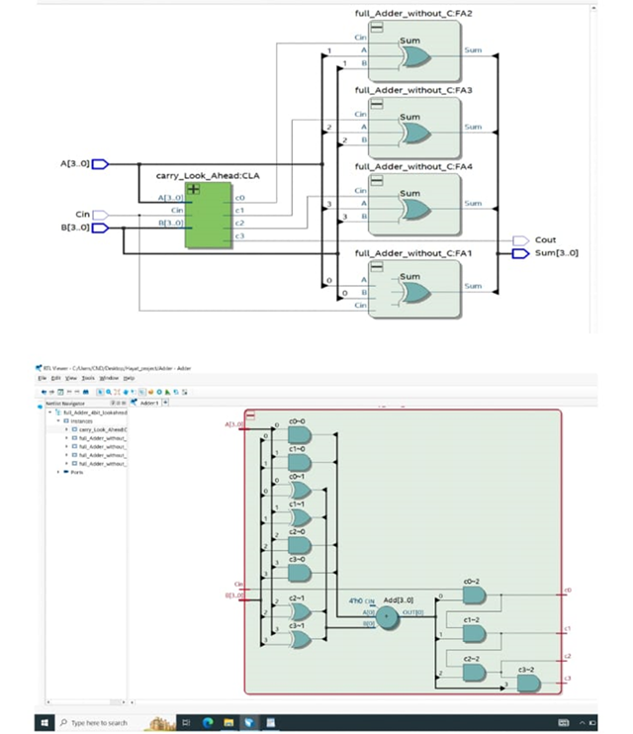
Implementation
4-Bit Carry Lookahead Adder Output Netlist

Slide 25
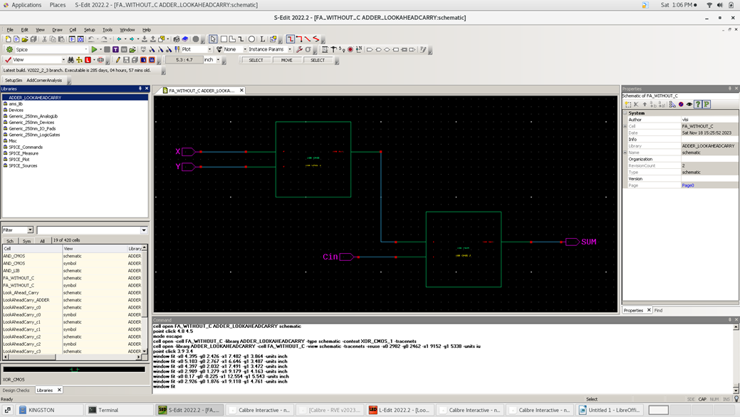
1-Bit FULL ADDER Without Carry
Schematic

Slide 26
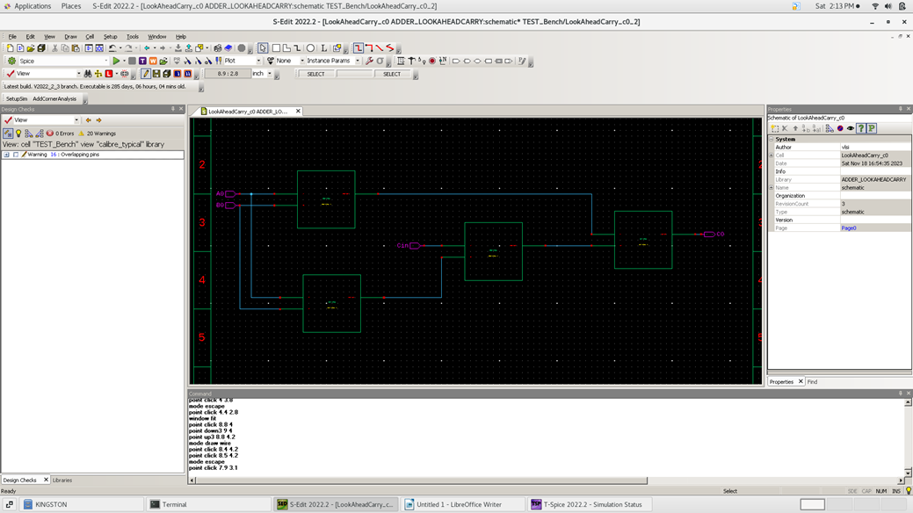
Carry Lookahead for c0
Schematic

Slide 27
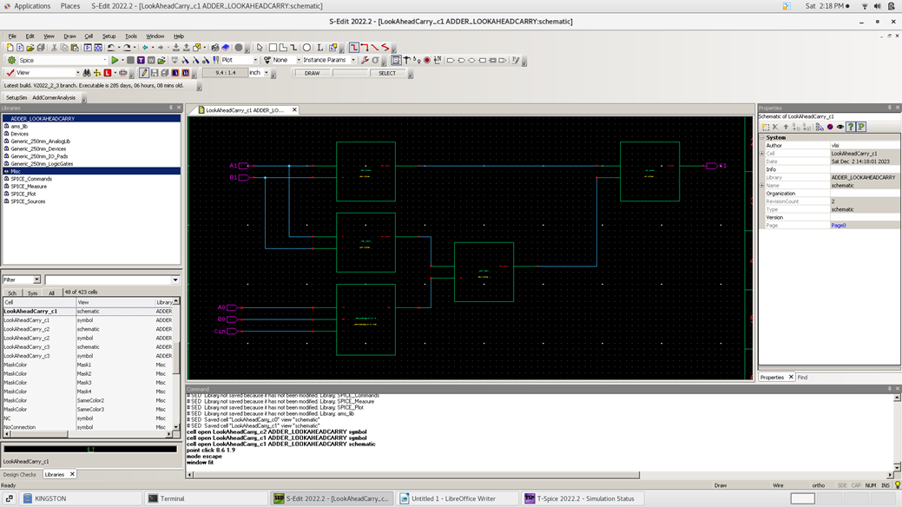
Carry Lookahead for c1
Schematic

Slide 28
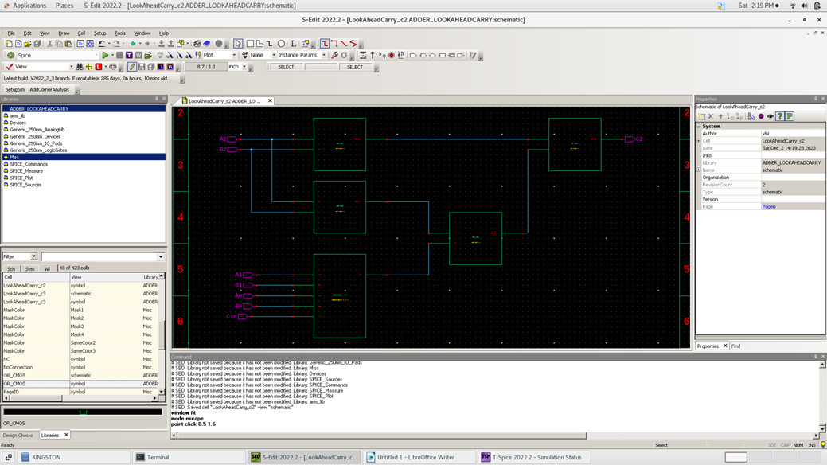
Carry Lookahead for c2
Schematic

Slide 29

Carry Lookahead for c3
Schematic

Slide 30
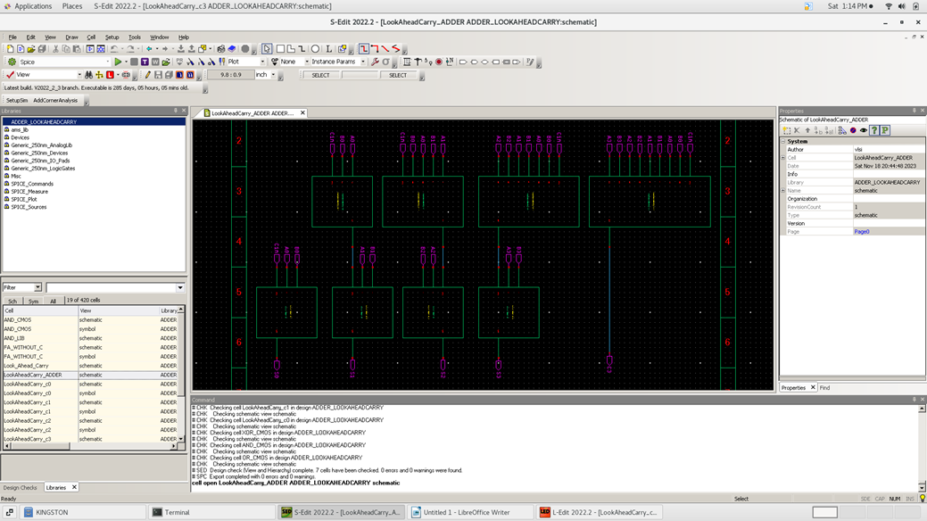
4-Bit carry lookahead adder
Schematic

Slide 31
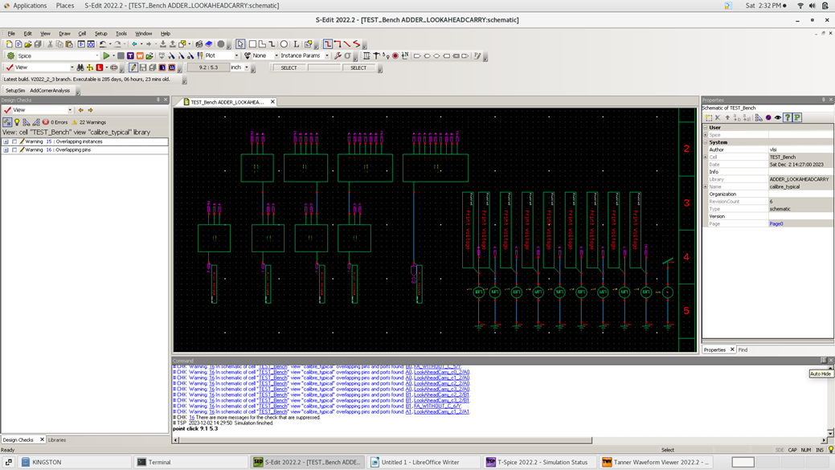
4-Bit CLA Adder Testbench
Schematic

Slide 32
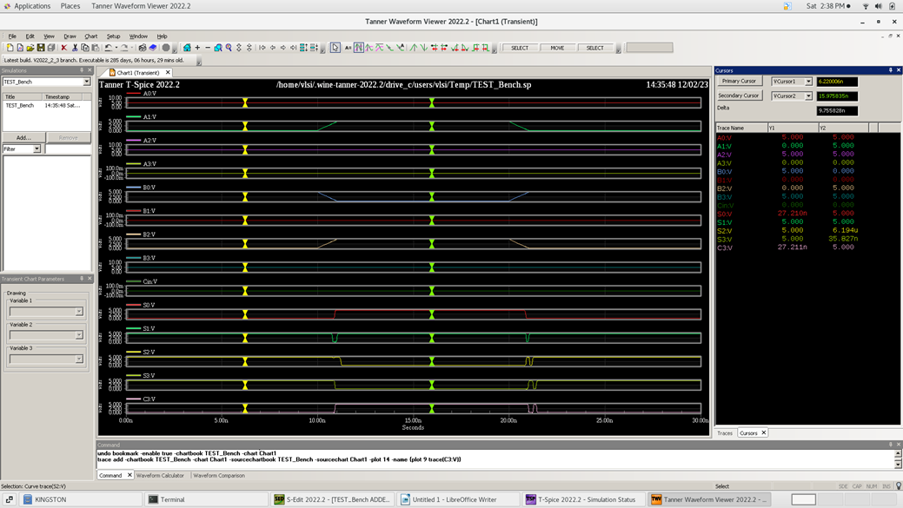
Simulation Results
First Pattern : 0101 + 1001 + 0 = 01110
Second Pattern : 0111 + 1100 + 0 = 10011

Slide 33
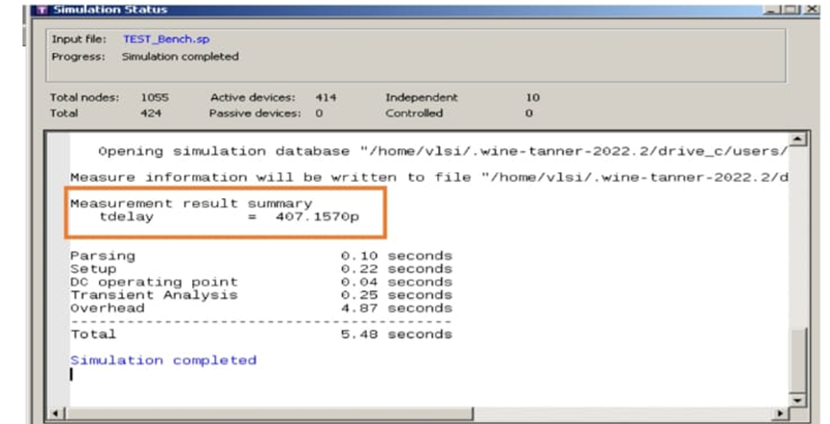
Simulation Results
Delay Calculations : Worst Case Delay

Slide 34
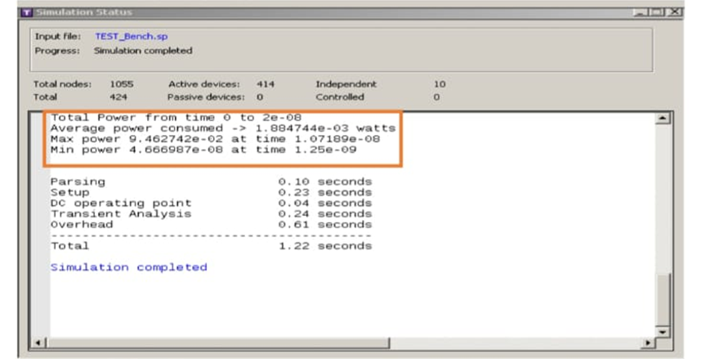
Simulation Results
Power Calculations

Slide 35
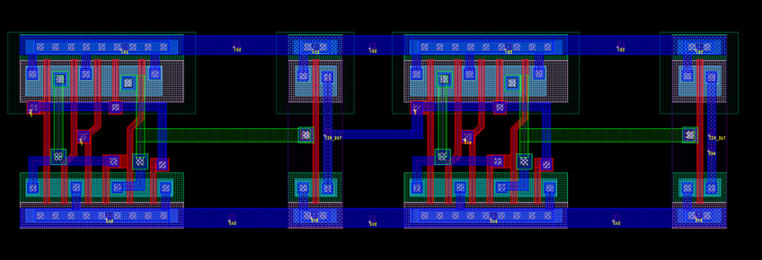
1-Bit FULL ADDER Without Carry
Layout

Slide 36
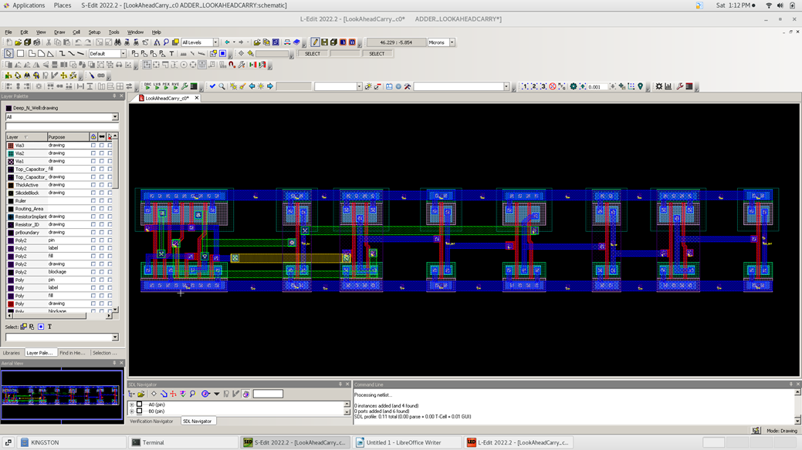
Carry lookahead for c0
Layout

Slide 37
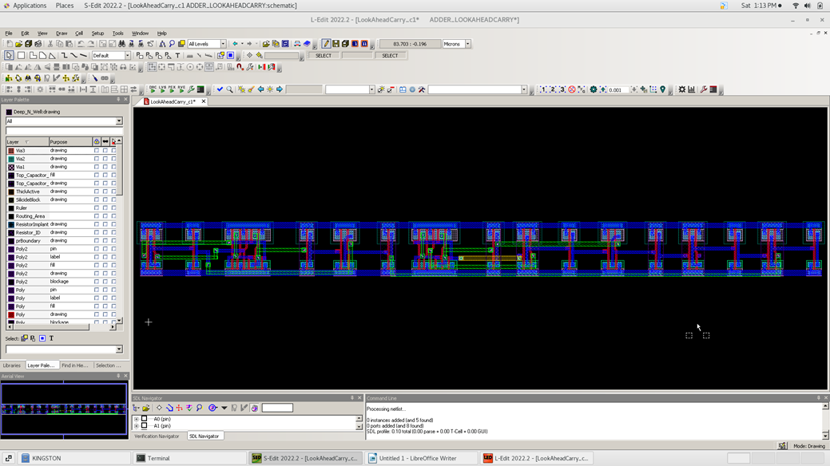
Carry lookahead for c1
Layout

Slide 38
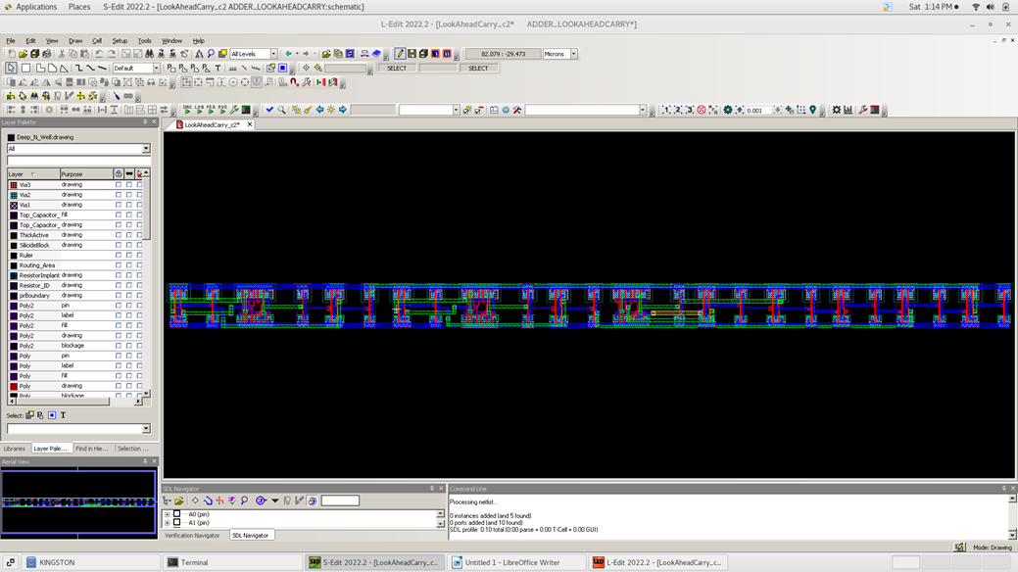
Carry lookahead for c2
Layout

Slide 39
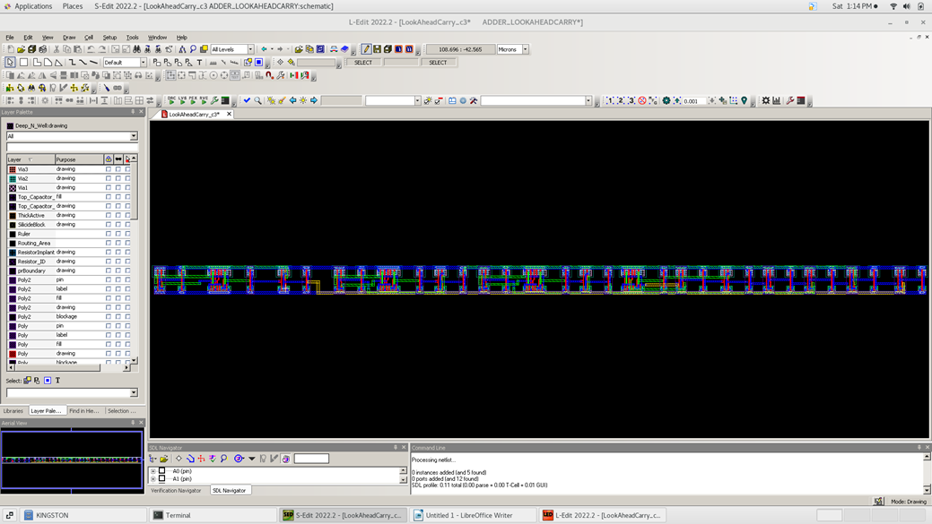
Carry lookahead for c3
Layout

Slide 40
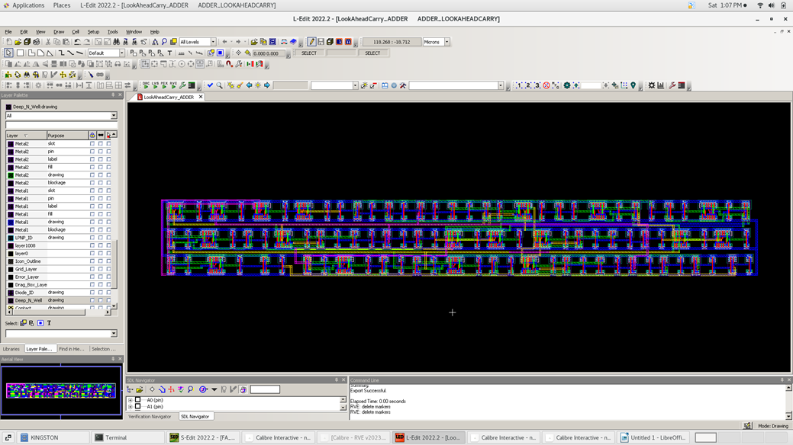
4-bit Carry lookahead ADDER
Layout

Slide 41
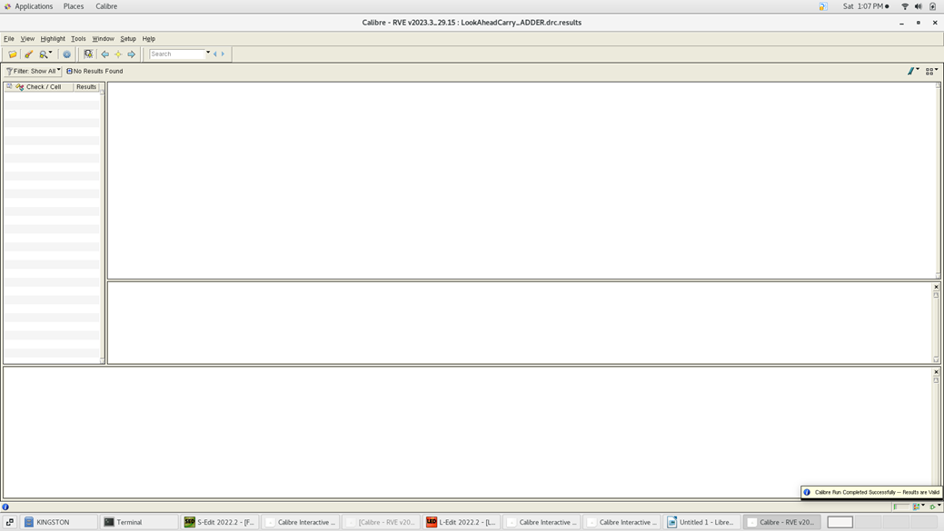
DRC CHECK

Slide 42
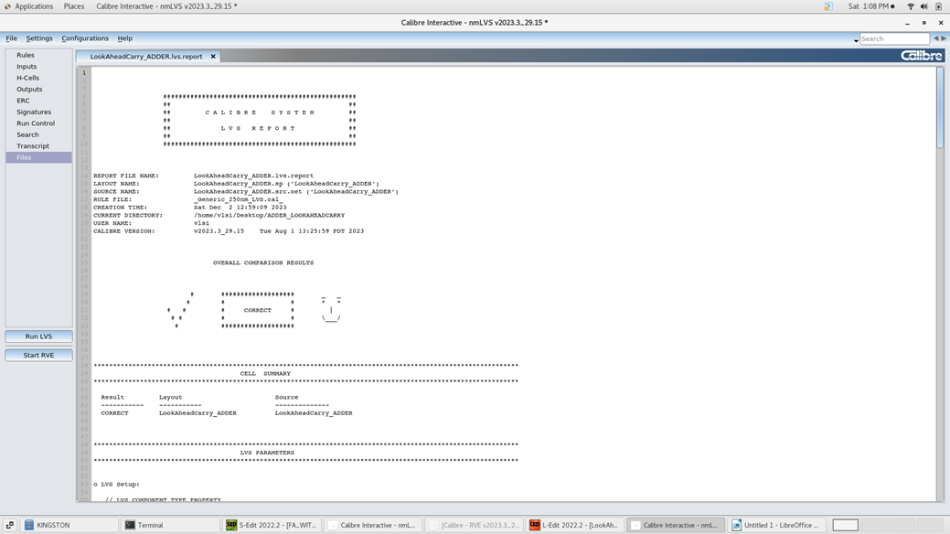
LVS CHECK

Slide 43
SUMMARY
 | Ripple Carry | Carry lookahead
Area | 100 Transistor | 400 Transistor
Delay | 601.6463p | 407.157p
Power | 1.108348e-3 watt | 1.88477e-3 watt

Slide 44
Question ?

Slide 45
Thanks

